Slide 1
HNDIT2401 Computer Architecture
Week 3: Internal Components of CPU and its functions

Slide 2
CPU
The central processing unit (CPU) is responsible for fetching program instructions, decoding each instruction that is fetched, and performing the indicated sequence of operations on the correct data.
The performance of a machine is directly affected by the design of the datapath and the control unit.

Slide 3
CPU Function
CPU must:
Fetch instructions
Interpret/decode instructions
Fetch data
Process data
Write data
Notes:
22

Slide 4
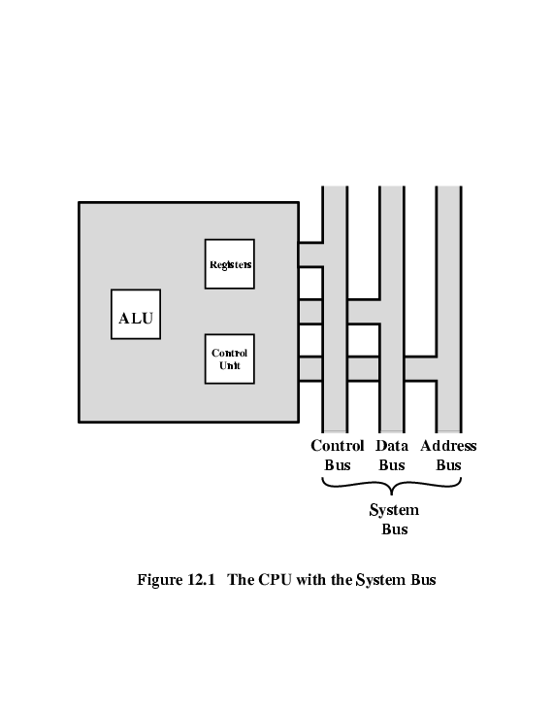
CPU With Systems Bus

Slide 5
CPU Basics and Organization
Registars
The ALU
The Control Unit
The Bus
Clocks

Slide 6
The ALU
The arithmetic logic unit (ALU) carries out the logic operations (such as comparisons)and arithmetic operations (such as add or multiply) required during the program execution.
Generally an ALU has two data inputs and one data output. Operations performed in the ALU often affect bits in the status register (bits are set to indicate actions such as whether an overflow has occurred). The ALU knows which operations to performbecause it is controlled by signals from the control unit.

Slide 7
Control Unit
The control unit is the “policeman” or “traffic manager” of the CPU. It monitors the execution of all instructions and the transfer of all information.
The control unit extracts instructions from memory, decodes these instructions, making sure data is in the right place at the right time, tells the ALU which registers to use, services interrupts, and turns on the correct circuitry in the ALU for the execution of the desired operation.
The control unit uses a program counter register to find the next instruction for execution and a status register to keep track of overflows, carries, borrows,etc

Slide 8
Bus
The CPU communicates with the other components via a bus.
A bus is a set of wires that acts as a shared but common data path to connect multiple subsystems within the system.

Slide 9
Clocks
Every computer contains an internal clock that regulates how quickly instructions can be executed.
The clock also synchronizes all of the components in the system.As the clock ticks, it sets the pace for everything that happens in the system,much like a metronome or a symphony conductor.
instruction performance is often measured in clock cycles—the time between clock ticks—instead of seconds
Most machine instructions require 1 or 2 clock cycles, but some can take 35 or more.

Slide 10
CPU With Systems Bus
major components of the processor are an arithmetic and logic unit (ALU) and a control unit (CU). In addition, consisting of a set of storage locations, called registers.
The ALU does the actual computation or processing of data.
The control unit controls the movement of data and instructions into and out of the processor and controls the operation of the ALU.

Slide 11
Registers
a Register is a hardware device that stores binary data. Registers are located on the processor so information can be accessed very quickly CPU must have some working space (temporary storage) - registers
Number and function vary between processor designs - one of the major design decisions
Top level of memory hierarchy.
D flip-flops can be used to implement registers.
Notes:
23

Slide 12
Registers
The registers in the processor perform two roles:
User-visible registers: Enable the machine- or assembly language programmer to minimize main memory references by optimizing use of registers.
Control and status registers: Used by the control unit to control the operation of the processor and by privileged, operating system programs to control the execution of programs.

Slide 13
MARIE ARCHI
MARIE, a Machine Architecture that is Really Intuitive and Easy, is a simplearchitecture consisting of memory (to store programs and data) and a CPU (consisting of an ALU and several registers).
It has all the functional components necessary to be a real working computer

Slide 14
MARIE registers
AC: The accumulator, which holds data values. This is a general purpose register and holds data that the CPU needs to process. Most computers today have multiple general purpose registers.
MAR: The memory address register, which holds the memory address of the data being referenced.
MBR: The memory buffer register, which holds either the data just read from memory or the data ready to be written to memory.
PC: The program counter, which holds the address of the next instruction to be executed in the program.
IR: The instruction register, which holds the next instruction to be executed.
InREG: The input register, which holds data from the input device.
OutREG: The output register, which holds data for the output device.

Slide 15
MARIE has the following characteristics:
Binary, two’s complement
Stored program, fixed word length
Word (but not byte) addressable
4K words of main memory (this implies 12 bits per address)
16-bit data (words have 16 bits)
16-bit instructions, 4 for the opcode and 12 for the address
A 16-bit accumulator (AC)
A 16-bit instruction register (IR)
A 16-bit memory buffer register (MBR)
A 12-bit program counter (PC)
A 12-bit memory address register (MAR)
An 8-bit input register
An 8-bit output register

Slide 16
User Visible Registers
General Purpose
Data
Address
Condition Codes
Notes:
24

Slide 17
General Purpose Registers (1)
May be true general purpose
May be restricted
May be used for data or addressing
Data: accumulator (AC)
Addressing: segment (cf. virtual memory), stack (points to top of stack, cf. implicit addressing)
Notes:
25

Slide 18
General Purpose Registers (2)
Make them general purpose
Increased flexibility and programmer options
Increased instruction size & complexity, addressing
Make them specialized
Smaller (faster) but more instructions
Less flexibility, addresses implicit in opcode
Notes:
26

Slide 19
How Many GP Registers?
Between 8 - 32
Less = more memory references
More takes up processor real estate
Notes:
27

Slide 20
How big?
Large enough to hold full address
Large enough to hold full data types
But often possible to combine two data registers or two address registers by using more complex addressing (e.g., page and offset)
Notes:
28

Slide 21
Condition Code Registers – Flags
Sets of individual bits, flags
e.g., result of last operation was zero
Can be read by programs
e.g., Jump if zero – simplifies branch taking
Can not (usually) be set by programs
Notes:
29

Slide 22
Control & Status Registers
Program Counter (PC)
Instruction Register (IR)
Memory Address Register (MAR) – connects to address bus
Memory Buffer Register (MBR) – connects to data bus, feeds other registers
Notes:
30

Slide 23
Program Status Word
A set of bits
Condition Codes:
Sign (of last result)
Zero (last result)
Carry (multiword arithmetic)
Equal (two latest results)
Overflow
Interrupts enabled/disabled
Supervisor/user mode
Notes:
31

Slide 24
Supervisor Mode
Intel ring zero
Kernel mode
Allows privileged instructions to execute
Used by operating system
Not available to user programs
Notes:
32

Slide 25
Other Registers
May have registers pointing to:
Process control blocks (see OS)
Interrupt Vectors (see OS)
N.B. CPU design and operating system design are closely linked
Notes:
33

Slide 26
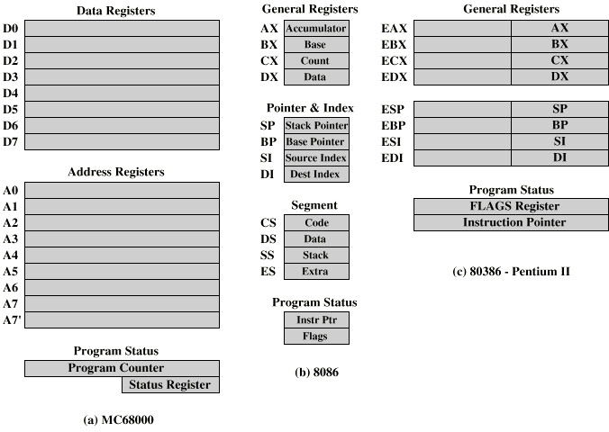

Slide 27
MC68000 and Intel registers
Motorola:
Largely general purpose registers – explicit addressing
Data registers also for indexing
A7 and A7’ for user and kernel stacks
Intel
Largely specific purpose registers – implicit addressing
Segment, Pointer & Index, Data/General purpose
Pentium II – backward compatibility

Slide 28
Indirect Cycle
Same address can refer to different arguments (by changing the content of the location the address is pointing to)
Indirect addressing requires more memory accesses to fetch operands
Can be thought of as additional instruction subcycle

Slide 29
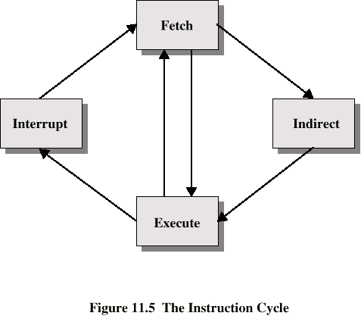
Instruction Cycle with Indirect

Slide 30
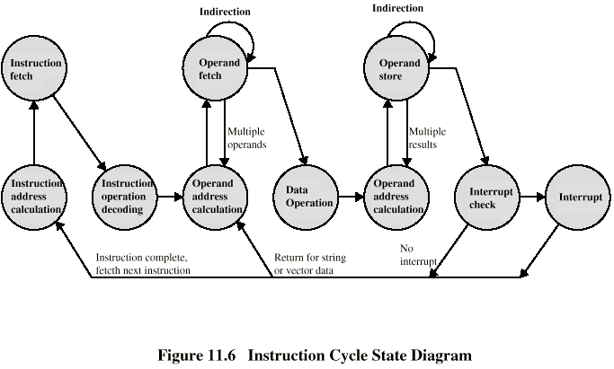
Instruction Cycle State Diagram

Slide 31
Data Flow (Instruction Fetch)
PC contains address of next instruction
Address moved to MAR
Address placed on address bus
Control unit requests memory read
Result placed on data bus, copied to MBR, then to IR
Meanwhile PC incremented by 1

Slide 32
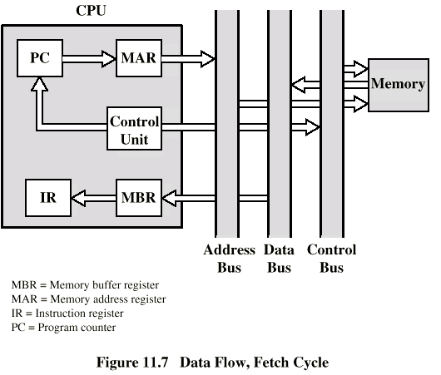
Data Flow (Fetch Diagram)

Slide 33
Data Flow (Data Fetch)
IR is examined
If indirect addressing, indirect cycle is performed
Rightmost n bits of MBR (address part of instruction) transferred to MAR
Control unit requests memory read
Result (address of operand) moved to MBR

Slide 34
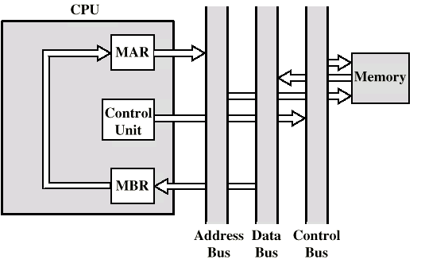
Data Flow (Indirect Diagram)

Slide 35
Data Flow (Execute)
May take many forms, depends on instruction being executed
May include
Memory read/write
Input/Output
Register transfers
ALU operations

Slide 36
Data Flow (Interrupt)
Current PC saved to allow resumption after interrupt
Contents of PC copied to MBR
Special memory location (e.g., stack pointer) loaded to MAR
MBR written to memory according to content of MAR
PC loaded with address of interrupt handling routine
Next instruction (first of interrupt handler) can be fetched

Slide 37
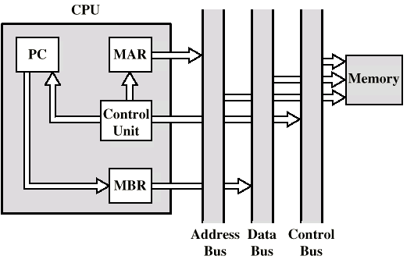
Data Flow (Interrupt Diagram)

Slide 38
Prefetch
Fetch involves accessing main memory
Execution of ALU operations do not access main memory
Can fetch next instruction during execution of current instruction, cf. assembly line
Called instruction prefetch
Notes:
36

